Slide 1

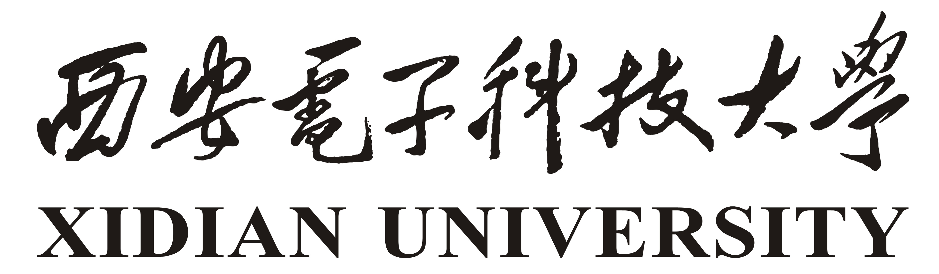
IEEE ICCT 2023
October 20-22, 2023
CNN-Based Synergetic Beamforming for Symbiotic Secure Transmissions in Integrated Satellite-Terrestrial Network
Zhaowei Wang
Zhisheng Yin
Xiucheng Wang
Nan Cheng
Yunchao Song
Tom H. Luan
1
2, *
2
2
3
1
zw_wang@stu.xidian.edu.cn
zsyin@xidian.edu.cn
xcwang_1@stu.xidian.edu.cn
dr.nan.cheng@ieee.org
songyc@njupt.edu.cn
tom.luan@xidian.edu.cn
1
School of Cyber Engineering, Xidian University, Xi’an, China
2
School of Telecommunications Engineering, Xidian University, Xi’an, China
3
College of Electronic and Optical Engineering, Nanjing University of Posts and Telecommunications, Nanjing, China
4
Corresponding author
Notes:
Hi everyone, this is the presentation of the our paper “CNN-Based Synergetic Beamforming for Symbiotic Secure Transmissions in Integrated Satellite-Terrestrial Network” , which proposes a synergetic beamforming scheme based on convolutional neural network (CNN) to achieve symbiotic security among heterogeneous downlinks in integrated satellite-terrestrial network.大家好，这是我们论文的演示，“基于卷积神经网络的综合卫星地面网络中协同波束赋形用于共生安全传输”，该论文提出了一种基于卷积神经网络（CNN）的协同波束赋形方案，旨在实现综合卫星地面网络中异构下行链路之间的共生安全。

Slide 2
CONTENT
1
Introduction
2
System Model
3
Beamforming Optimization
4
Numerical Result
Notes:
I will expand on my presentation from the following four aspects.我将从以下四个方面扩展我的演示：

Slide 3
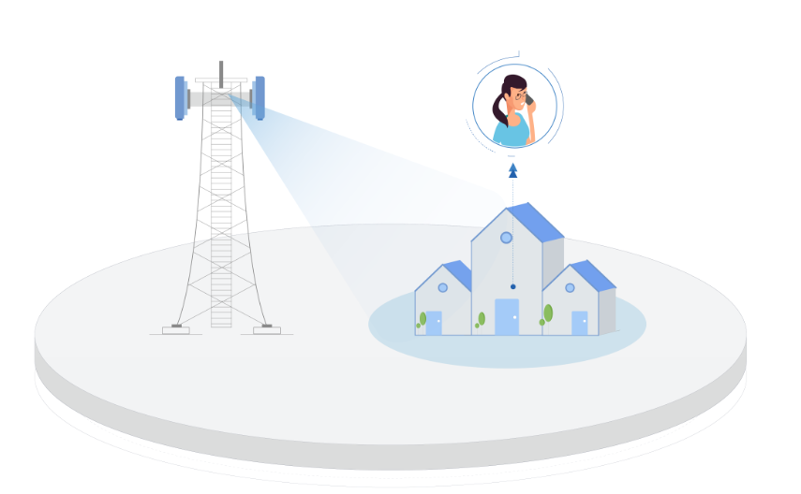
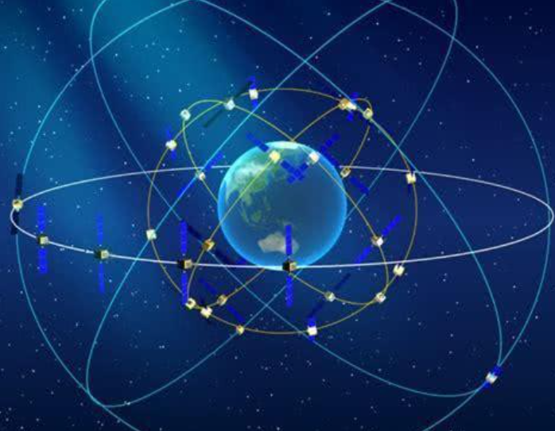
INTRODUCTION
Background
Terrestrial Network
Satellite Network
Cover remote and complex areas difficultly
Vulnerability to natural disasters that can bring down networks
Wide coverage and seamless connectivity
Satellite communications are vulnerable to eavesdropping threats
Notes:
Satellite networks have garnered widespread attention due to their extensive coverage, high spectral efficiency, and seamless connectivity, making them an effective solution for addressing the limitations of terrestrial networks in achieving comprehensive coverage.
In particular, due to the open nature and broad coverage of wireless channels, as well as the dynamic topology of satellite networks, communication in satellite-terrestrial network is vulnerable to eavesdropping threats.卫星网络因其广泛的覆盖范围、高频谱效率和无缝连接而引起了广泛关注，这使它们成为解决地面网络在实现全面覆盖方面的局限性的有效解决方案。
特别是由于无线信道的开放性质和广泛覆盖，以及卫星网络的动态拓扑，卫星-地面网络中的通信容易受到窃听威胁的影响。

Slide 4
INTRODUCTION
Key Technology
Spectrum Sharing
Co-channel interference from spectrum sharing can degrade performance. But strategic design can turn this interference into green interference and affect the main and eavesdropping channels differentially, leading to higher data security in the physical layer.
Physical Layer Security
Physical layer security harnesses the inherent randomness of wireless channels and physical layer technologies to achieve comprehensive information security safeguards. When the quality of the main channel surpasses that of the eavesdropping channel, legitimate users can achieve secure transmission through lossless coding.
Beamforming
Beamforming technology is widely used to adjust the beam direction of the transmitted signal. This technique enhances the signal strength at legitimate users' locations while diminishing the received signal quality for eavesdroppers, and improves the overall security performance of the system.
Notes:
In this paper, we integrate the following methods to collectively counter eavesdropping threats. 在本文中我们结合以下几种方法综合抵抗窃听威胁。
The co-channel interference caused by spectrum sharing always degrades the communication performance of the system, but it can be transformed into green interference and improve the system's security performance through physical layer design.
由频谱共享引起的同信道干扰总是会降低系统的通信性能，但是可以通过物理层的设计，将这种干扰转化为绿色干扰，提高系统的安全性能。
Physical layer techniques can leverage the inherent randomness of the wireless channels to achieve information security. When the quality of the main channel surpasses that of the eavesdropping channel, legitimate users can achieve secure transmission through lossless coding.
物理层技术可以利用无线信道的随机性实现信息安全。只要主信道信道质量大于窃听信道质量时，总可以通过无损编码实现安全传输
Precisely, beamforming technology can adjust the direction of the beam to enhance the channel quality of the main channel and reduce the channel quality of the eavesdropping channel.
恰好，波束赋形技术可以调整波束的方向，以增强主信道的信道质量并降低窃听信道的信道质量。

Slide 5
INTRODUCTION
Inductive bias
Inductive bias of the NN leads balanced features extracting for the input elements at the initial, since the NN cannot directly learn from the structure of the data input which two elements are for the real and imaginary parts of a complex data.
Prior knowledge of the channel state is the channel information corresponding to different antennas, different users, and satellite or base station.
Notes:
Inductive bias of the NN leads balanced features extracting for the input elements at the initial, since the NN cannot directly learn from the structure of the data input which two elements are for the real and imaginary parts of a complex data.
NN的归纳偏置导致初始时为输入元素提取平衡特征， 因为 NN 不能直接从数据输入的结构中学习哪两个元素用于复杂数据的实部和虚部。
Naively flattening the complex data as a one-dimension vector will definitely decreasing the performance and convergence speed of the NN.
天真地将复杂数据扁平化为一维向量肯定会降低神经网络的性能和收敛速度
And prior knowledge of the channel state is the channel information corresponding to different antennas, different users, and satellite or base station.
并且对信道状态的先验知识是信道信息是相关的关于不同天线、不同用户、卫星和基站。

Slide 6

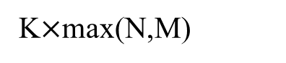
INTRODUCTION
Specific Design
K$×$max(N,M)
0
Real
$$∗$$
Kernel
Imaginary
Notes:
So, designing NN with an inductive bias for complex data features, and extracting correlations about channel state information, is promising for improving NN performance with reduced training cost, such inductive bias can be obtained by designing the structure of input data and the NN .
因此，为了改善神经网络的性能并降低训练成本，可以设计带有归纳偏差的神经网络，用于处理复杂的数据特征并提取关于信道状态信息的相关性。这种归纳偏差可以通过设计输入数据的结构和神经网络的结构来获得。
So, by concatenating the real and imaginary part of the complex CSI matrix through the third dimension of the matrix as a tensor, the real CSI is explicitly correlated with the corresponding imaginary CSI. As for channel correlation, a 3-dimensional convolution kernel with a specific size can be used to extract features of correlated CSI elements. 所以，通过将复杂CSI矩阵的实部和虚部通过矩阵的第三维度连接为一个张量，可以明确地将实际CSI与相应的虚拟CSI相关联起来。
至于信道相关性，可以使用具有特定大小的三维卷积核来提取相关的CSI元素的特征。
Thus, in this paper, a CNN with a specific kernel size is designed to optimize the precoding matrix, that the size of the convolution kernel in the first dimension is equal to the number of legitimate users and eavesdroppers, and the size of second dimension is equal to the number of antennas to introduce the inductive bias about multiple antennas, while the size of the third dimension is just equal to 2 to learn the correlation between real and imaginary data.因此，在本文中，设计了一个具有特定卷积核大小的CNN来优化预编码矩阵。其中，第一维的卷积核大小等于合法用户和窃听者的数量，第二维的大小等于天线的数量，以引入关于多个天线的归纳偏差，而第三维的大小正好等于2，以学习实部和虚部数据之间的相关性。

Slide 7
INTRODUCTION
Main Contributions
CNN Structure
A unique CNN structure is designed to cater to complex data in MU-MISO systems. By transforming the complex CSI matrix into a tensor and employing a 3-dimensional convolution kernel, the correlation between real and imaginary parts of the complex data was efficiently realized, which is expected to optimize performance.
Unsupervised Learning
A novel unsupervised learning approach for SINR optimization is adopted. Instead of relying on computationally challenging optimal solutions as labels, the updating gradient of the parameters is computed through the objective function using the chain rule.
Notes:
So, the specific design of our paper can be summarized as the following two points: 因此我们这篇论文的详细设计可以归纳为以下两点
The first is CNN Structure:
The second is unsupervised learning:

Slide 8
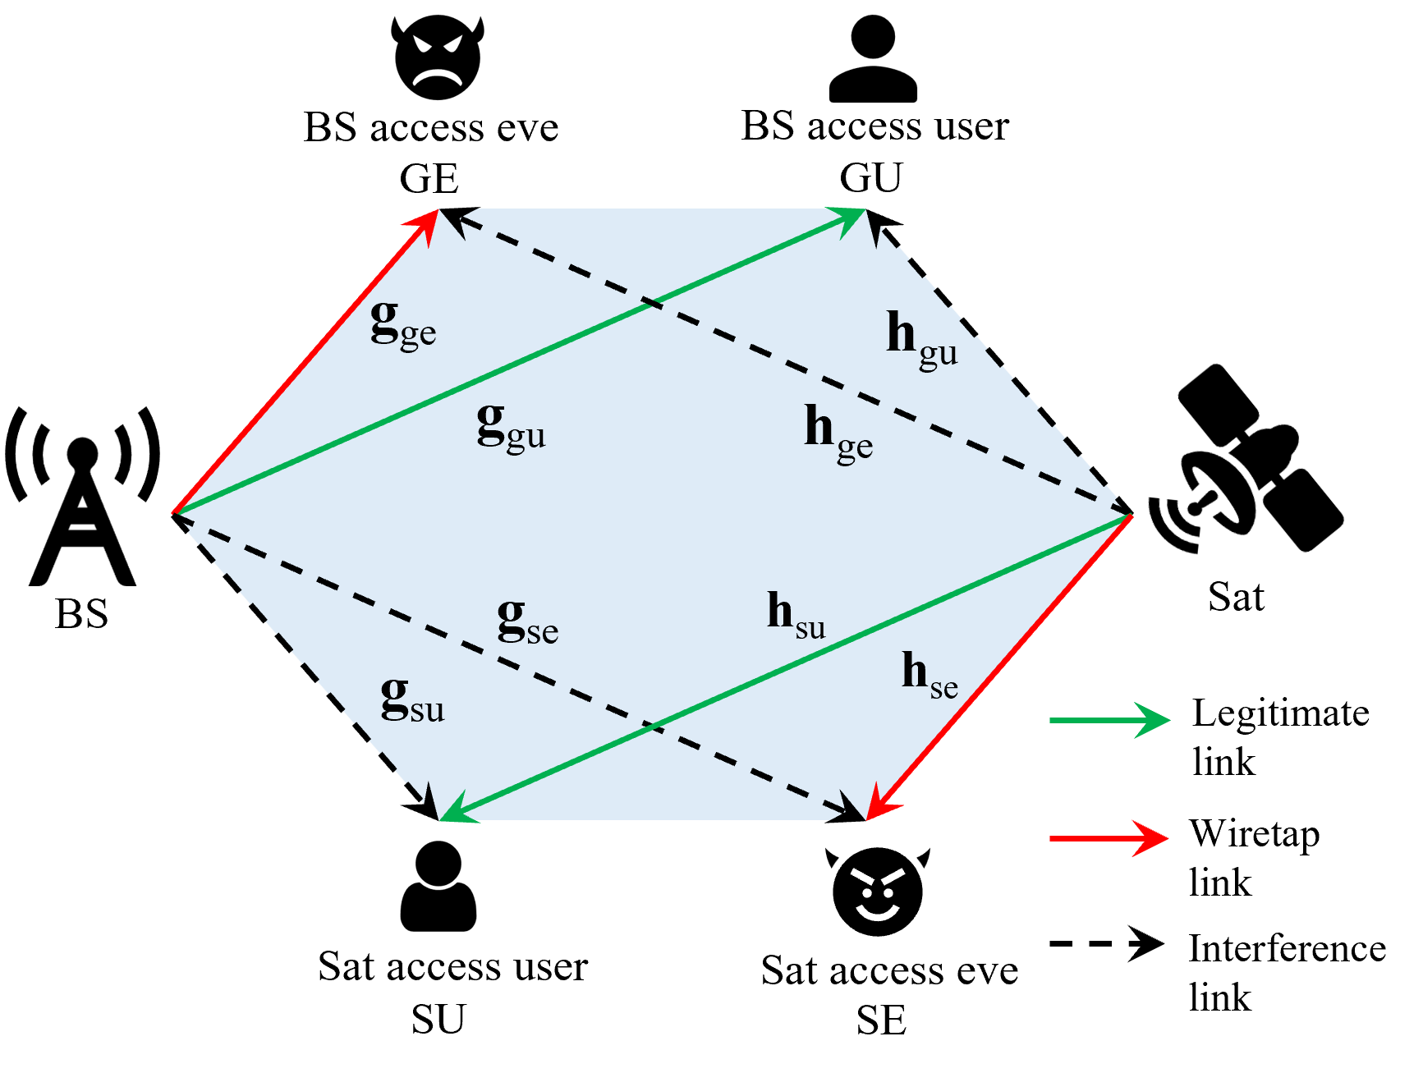
SYSTEM MODEL
System Model
Notes:
In system model, we consider secure transmission in the downlink communication of an integrated satellite-terrestrial network, We assume the presence of a multi-antenna satellite and a multi-antenna base station . Within the overlapping coverage area of the Sat and BS, there exists a Sat user named SU, a Sat eavesdropper named SE, a BS user named GU, and a BS eavesdropper named GE. All the users are equipped with a single antenna. The spectrum is shared among all users. By leveraging co-channel interference to its fullest extent, we optimize beamforming vectors that differentially affect the main and eavesdropping channels, thereby ensuring secure transmission in the integrated satellite-terrestrial network.我们考虑了在综合卫星-地面网络的下行通信中实现安全传输的问题。我们假设网络中存在多天线卫星和多天线基站。在卫星（Sat）和基站（BS）的重叠覆盖区域内，存在以下实体：一名卫星用户（SU），一名卫星窃听者（SE），一名基站用户（GU）和一名基站窃听者（GE）。所有用户都配备了单天线。频谱由所有用户共享。通过充分利用同信道干扰，我们优化波束赋形向量，以不同程度影响主信道和窃听信道，从而确保综合卫星-地面网络中的安全传输。

Slide 9
SYSTEM MODEL
Channel Model
Satellite link:
Terrestrial link:
follows Nakagami-m fading.
Notes:
We model the channel as follows. 我们对信道进行如下建模。
In the satellite link model, C_L represents free space loss, $\lambda$ represents the wavelength of the signal, $d$ signifies the horizontal distance from the center of Sat beam to the terrestrial user, and $l$ represents the satellite's height. $\beta$ represents the channel gain due to rain attenuation, which follows a log-normal random variable with $\beta _{dB}$ is the $dB$ form of $\beta$. $\theta$ is a phase vector . $b$ represents the satellite beam gain. where $G$ represents the maximum gain of the satellite antenna, with u_0 is a parameter related to $\alpha$ .$\alpha$ is the elevation angle between the beam center and the user, $\alpha _{3dB}$ is the $3dB$ angle of the Sat beam, and $J_1$ and $J_3$ are the first and third order the first kind Bessel function. Therefore, {h}_{gu} {h}_{ge} {h}_{su} {h}_{se} represent the channel vectors from the Sat to the GU, GE, SU, SE, respectively, and $N$ denotes the number of antennas of Sat.
In the terrestrial link model, Where $a$ represents large-scale fading, $C_0$ denotes the channel power gain at a reference distance of 1 meter, $r$ signifies the distance from the BS to the terrestrial user. $g_0$ represents small-scale fading, following a Nakagami-$m$ distribution.
Therefore,{g}_{gu} {g}_{ge} {g}_{su} {g}_{se} respectively represent the channel vectors from the BS to the GU, GE, SU, SE. $M$ denotes the number of antennas of BS.

Slide 10
SYSTEM MODEL
Signal Model
Legitimate User
Eavesdropper
Signal
Signal
SINR
SINR
Secrecy Rate
Notes:
Using $x_{gu}$ to represent the signal transmited by the BS and $x_{su}$ for the signal transmitted by the Sat, the received signals at GU , SU, GE, SE can be respectively expressed as shown.
使用 $x_{gu}$ 代表基站发送的信号，$x_{su}$ 代表卫星发送的信号，GU SU GE SE 接收到的信号分别可以表示如下。
Where $n_{gu}$ and $n_{su}$ represent the noise when receiving signals at GU and SU, respectively. {w}_{g} and {w}_{s} respectively represent the beamforming vector of BS and Sat. The signals received by eavesdroppers GE and SE can be represented as shown:
其中，$n_{gu}$ 和 $n_{su}$ 分别代表 GU 和 SU 接收信号时的噪声。$n_{ge}$ 和 $n_{se}$ 分别代表 GE 和 SE 接收信号时的噪声. ${w}_{g}$ 和 ${w}_{s}$ 分别代表基站和卫星的波束成形矢量。
the SINR when legitimate users GU and SU and eavesdroppers GE and SE receive signals can be expressed as shown:
合法用户 GU 和 SU 接收信号的信噪比 (SINR) 可以表示如下：
Therefore, based on the definition of secrecy rate, the secrecy rates for GU and SU can be expressed as shown:
因此，根据安全速率的定义，GU SU的安全速率可以表示为：

Slide 11
SYSTEM MODEL
Signal Model
Notes:
For analytical convenience, we assume that the noise power is normalized. The secrecy rates for GU and SU can be represented as shown.
为了便于分析，我们假设噪声功率是归一化的。GU和SU的保密率可以表示为如下所示。

Slide 12
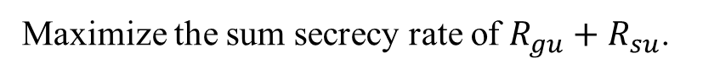
SYSTEM MODEL
Problem Formulation
Maximize the sum secrecy rate of $R_{gu}+R_{su}$.
Enforce the predefined secrecy rate constraint for the link from the BS to GU and from the Sat to SU.
Impose the constraint on the maximum transmit power of BS and Sat.
Notes:
To enhance the secrecy performance of both GU and SU, the problem in this paper can be formulated as follows: 为了提高GU和SU的保密性能，本文中的问题可以表述如下：
Where $P_g$ and $P_s$ represent the maximum transmit power of BS and Sat, respectively. And $R_{gu}^{'}$ and $R_{su}^{'}$ represent the predefined secrecy rate constraints for GU and SU, respectively.
其中$P_g$和$P_s$分别表示BS和Sat的最大发射功率。$R_{gu}^{'}$和$R_{su}^{'}$分别表示gu和su的预定义保密率约束。
The objective function is to max the sum secrecy rate of $R_{gu}+R_{su}$. 目标函数是最大化R_gu和R_su的和安全速率。
The first two constraints Enforce the predefined secrecy rate constraint for the link from the BS to GU and from the Sat to SU.
前两个约束条件对从BS到GU以及从Sat到SU的链路实施预定义的保密率约束。
The last two constraints impose the constraint on the maximum transmit power of BS and Sat.
最后两个约束对BS和Sat的最大发射功率施加约束。

Slide 13
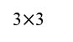
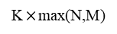

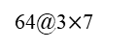
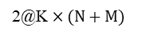
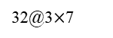
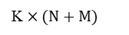

Beamforming Optimization
CNN Architecture(N=M=4)
2@K$×(N+M)$
K$×$max(N,M)
3$×$3
K$×(N+M)$
···
···
Real
$$∗$$
$$∗$$
Flatten
Complex
Beamforming
CSI
Imag
Real
···
Input
Imag
Kernel
Kernel
Output
Feature maps
Feature maps
···
···
32@3$×$7
64@3$×$7
LeakyReLU
LeakyReLU
Input layer∈R^{64*3*7}
Hidden layer ∈R²⁵⁶
Output layer ∈R¹⁶
Feature maps
Feature maps
Convolutional layers
Fully connected layers
Notes:
As shown in the figure, this network architecture consists of two layers of convolutional neural networks and two layers of fully connected neural networks. The input layer of the convolutional neural network section consists of two channels, namely channel R and channel I.

Slide 14
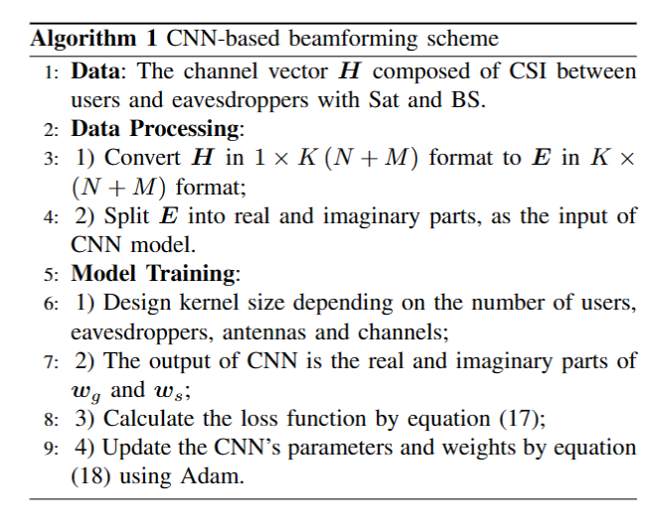
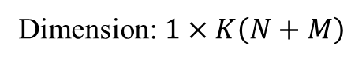
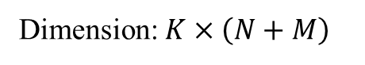
Beamforming Optimization
Data Process
Data
Dimension: $1×K\left(N+M\right)$
Data Process
Dimension: $K×\left(N+M\right)$
Notes:
The input data to the neural network is a channel vector $\boldsymbol{H}$ composed of CSI between users and eavesdroppers with Sat and BS, with a dimension of 1 times K left parenthesis N plus M right parenthesis, where K is the number of users and eavesdroppers.
神经网络的输入数据是信道向量$\boldsymbol｛H｝$，由具有Sat和BS的用户和窃听者之间的CSI组成，维度为1乘以K左括号N加M右括号，其中K是用户和窃听器的数量。
Then, the channel vector H} is divided into a K times ( N plus M) form, where each row of the matrix represents the CSI acquired by the same user or eavesdropper.
然后，信道向量H}被划分为K倍（N加M）的形式，其中矩阵的每一行表示由同一用户或窃听者获取的CSI。
The channel matrix E is then split into real and imaginary parts, which are used as inputs to the neural network. Where mathcal R represents the real part, mathcal I represents the imaginary part, $c_r$ represents the input for channel R, and $c_i$ represents the input for channel I.
然后将通道矩阵E分为实部和虚部，它们被用作神经网络的输入。其中mathcal R表示实部，mathcal I表示虚部，$c_R$表示通道R的输入，$c_I$表示通道I的输入。
The reasons for conducting data processing in this manner are as follows: firstly, partitioning the real and imaginary parts into separate channels is because there exists a certain correspondence between the real and imaginary parts, which can be learned through a dual-channel CNN. And then, each row of the K times N plus M matrix corresponds to the CSI received by a user or eavesdropper from BS and Sat, and each column represents the CSI from a specific antenna of a BS or Sat to the users and eavesdroppers.
采用这种方式进行数据处理的原因如下：首先，将实部和虚部划分为单独的通道是因为实部和虚部之间存在一定的对应关系，可以通过双通道CNN来学习。然后，K乘以N加M矩阵的每一行对应于用户或窃听者从BS和Sat接收到的CSI，并且每一列表示从BS或Sat的特定天线到用户和窃听者的CSI。

Slide 15
Beamforming Optimization
CNN
Output
Loss Function
Gradient Update
Adjustable Parameter
Notes:
After passing through the convolutional neural network, the output is flattened into a one-dimensional vector and fed into the fully connected network.
在通过卷积神经网络后，输出被平坦化为一维向量，并被馈送到完全连接的网络中。
The neural network's output is a 1x16 real-valued vector, structured as $kexi$, representing the real and imaginary parts of $ {w}_g$ and ${w}_s$.
神经网络的输出是一个1x16实值向量，结构为$kexi$，表示$的实部和虚部{w}_g$和${w}_s$。
The loss function consists of objective function and the constraint conditions, where $\epsilon_i$ and $\lambda_i$ are adjustable positive parameters.
损失函数由目标函数和约束条件组成，其中$\epsilon_i$和$\lambda_i$是可调整的正参数。

Slide 16
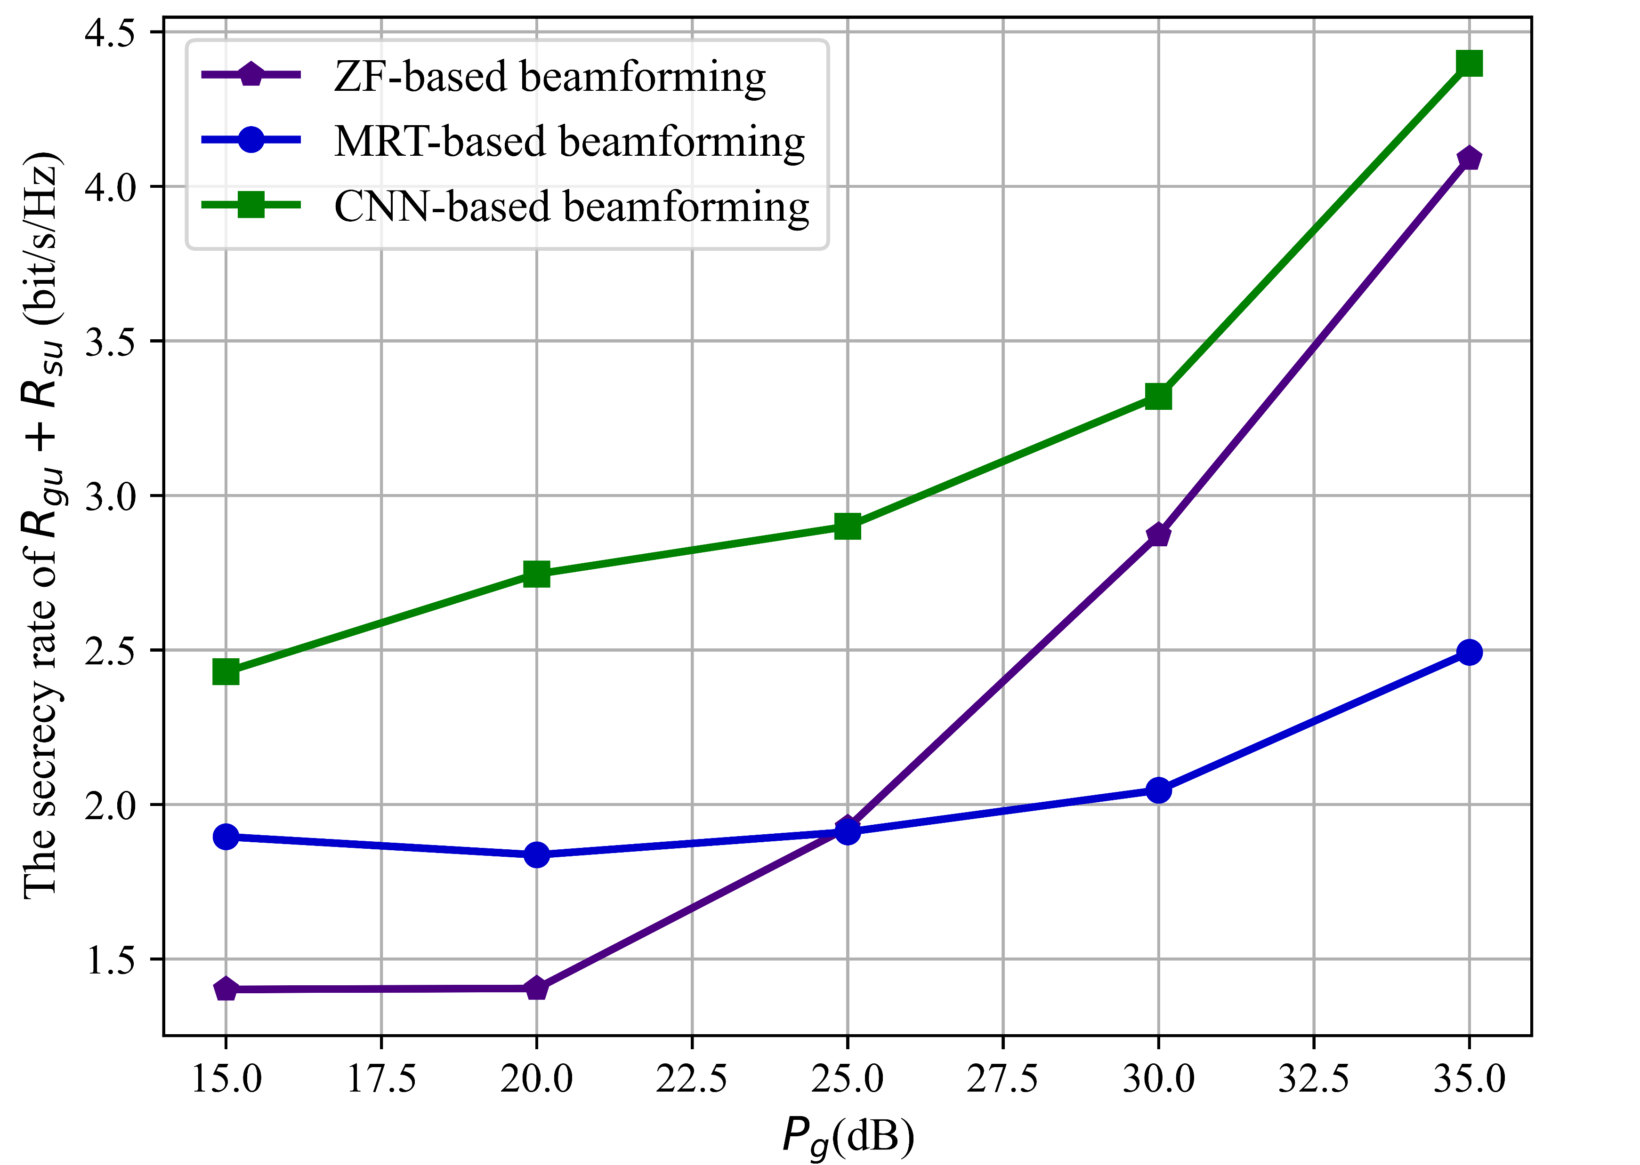
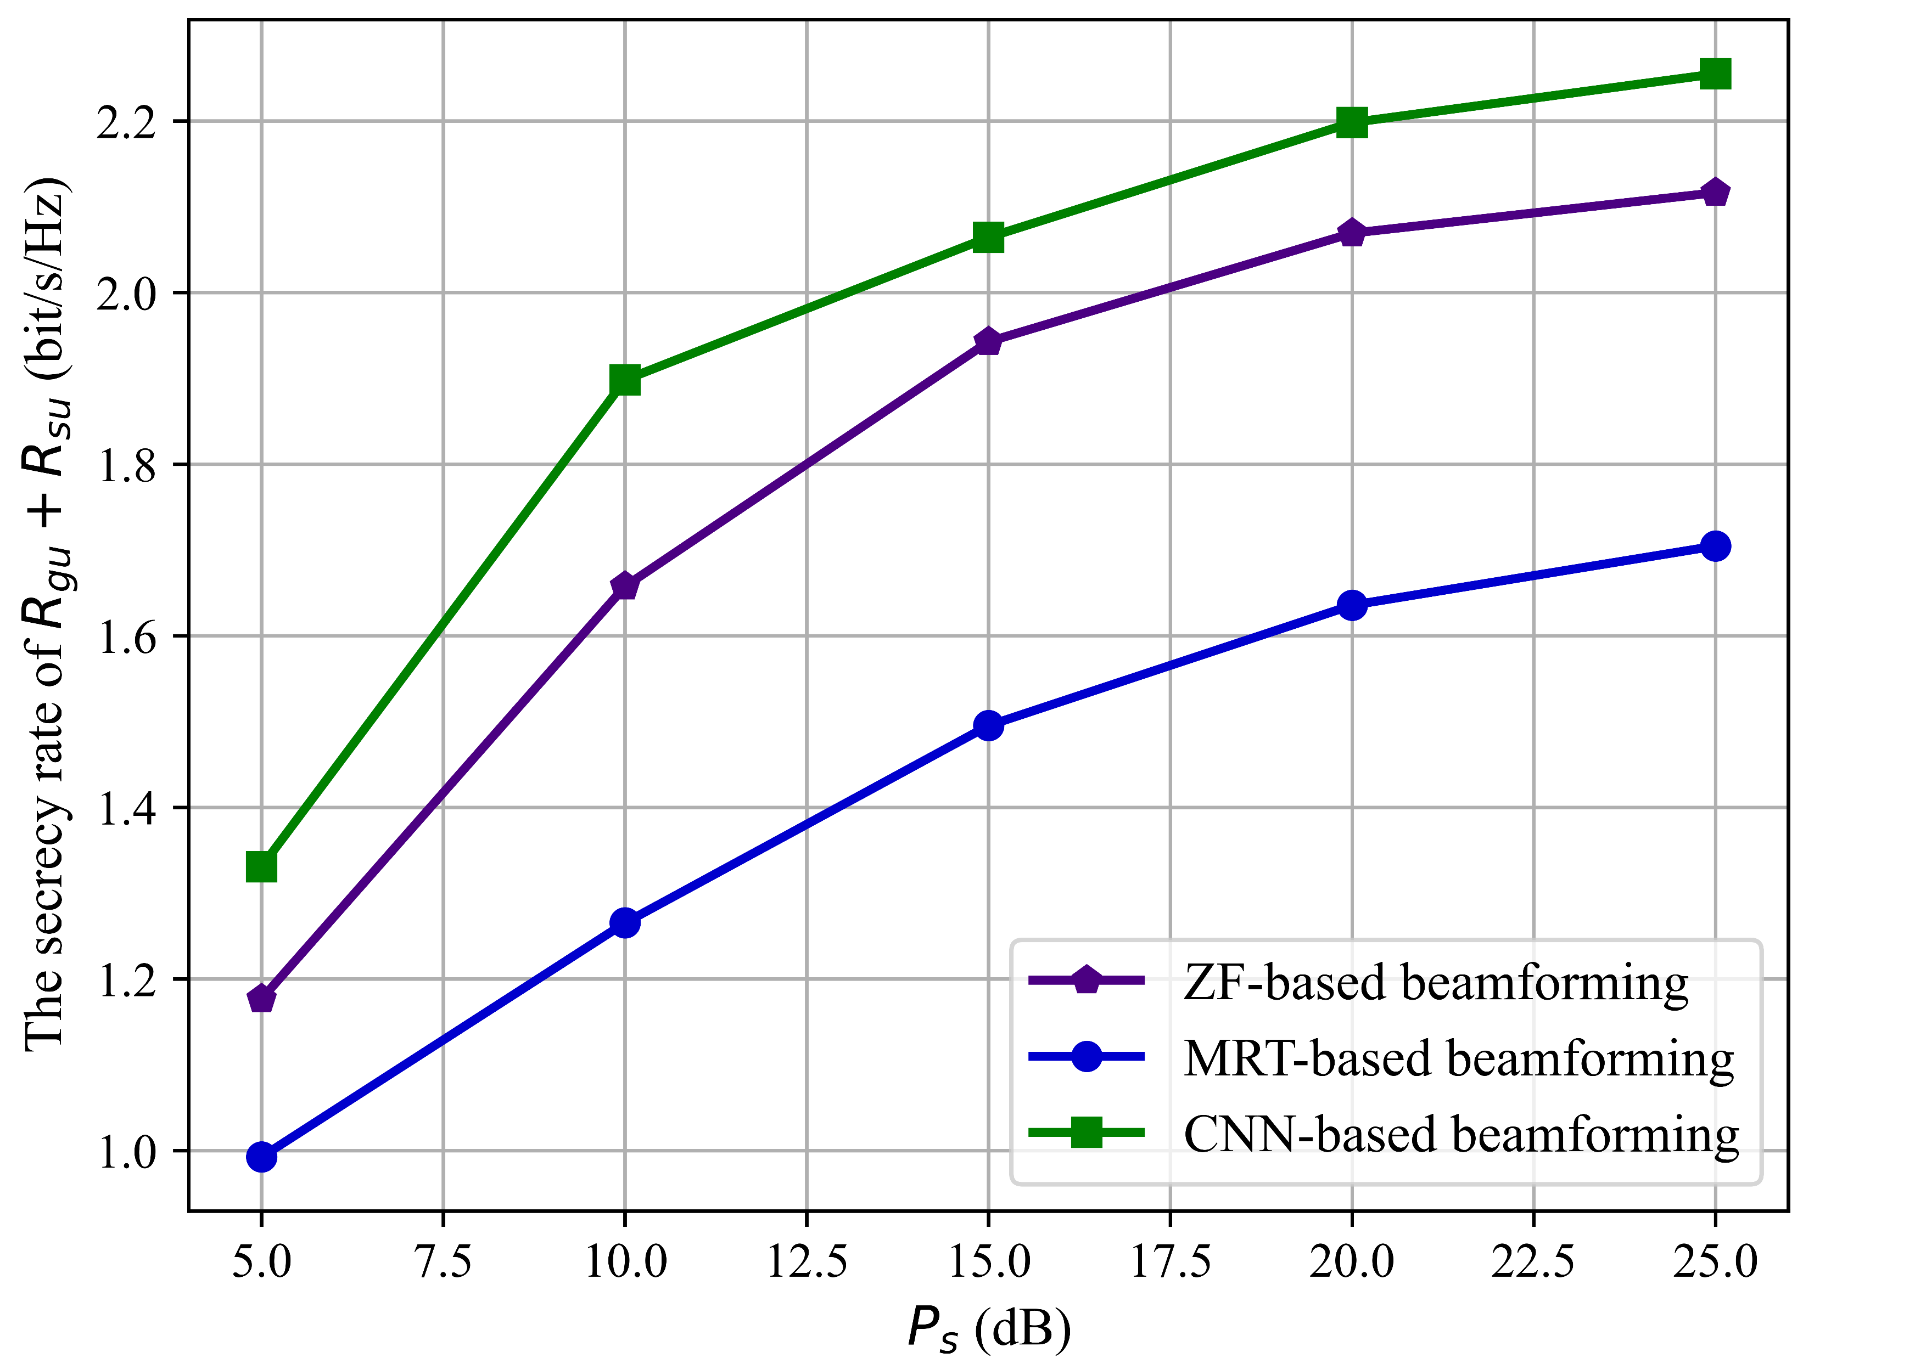
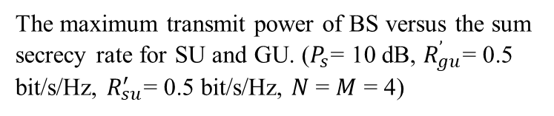
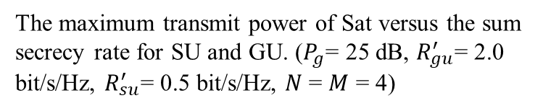
SIMULATION RESULT
The maximum transmit power of BS versus the sum secrecy rate for SU and GU. ($P_{s}$= 10 dB, $R_{gu}^{’}$= 0.5 bit/s/Hz, $R_{su}^{′}$= 0.5 bit/s/Hz, $N$= $M$ = 4)
The maximum transmit power of Sat versus the sum secrecy rate for SU and GU. ($P_{g}$= 25 dB, $R_{gu}^{′}$= 2.0 bit/s/Hz, $R_{su}^{′}$= 0.5 bit/s/Hz, $N$= $M$ = 4)
Notes:
These figures illustrate the relationship between the maximum transmit power of Sat or base station and the sum secrecy rate for GU and SU. We can observe that with the transmit power of Satellite or base station increasing, the sum secrecy rate of GU and SU increases. The CNN-based beamforming scheme proposed is superior to the MRT-based and ZF-based beamforming methods. This is because with the increase in transmit power of Sat or BS, there is remaining power that can be effectively utilized for exploiting green interference, enhancing the difference between the main channel and eavesdropping channels, and thereby improving security performance while still meeting the minimum secrecy rate requirements for both GU and SU.
这些图表展示了卫星或基站的最大发送功率与GU和SU的总保密率之间的关系。我们可以观察到，随着卫星或基站的发送功率增加，GU和SU的总保密率也增加。我们提出的基于CNN的波束成形方案优于基于MRT和基于ZF的波束成形方法。这是因为随着卫星或基站的发送功率增加，仍然存在可有效利用的余额功率，用于利用绿色干扰，增强主信道与窃听信道之间的差异，从而提高安全性能，同时仍然满足GU和SU的最低保密率要求。

Slide 17
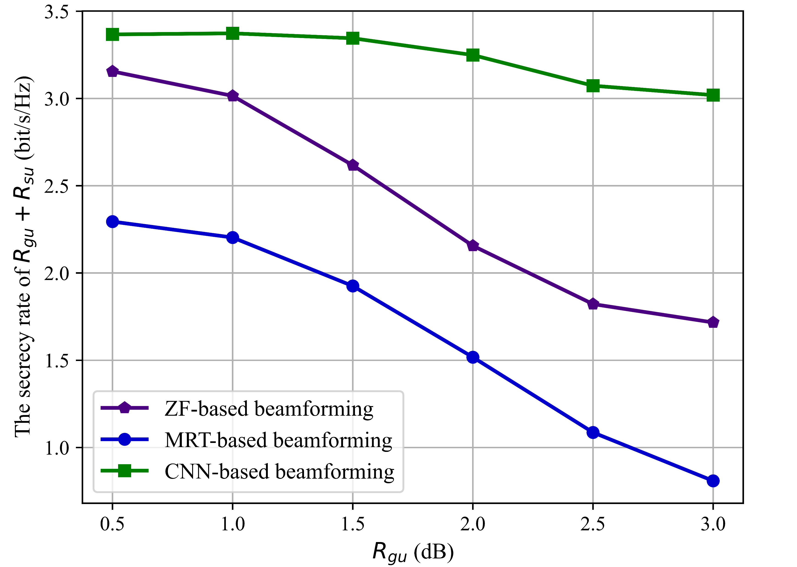
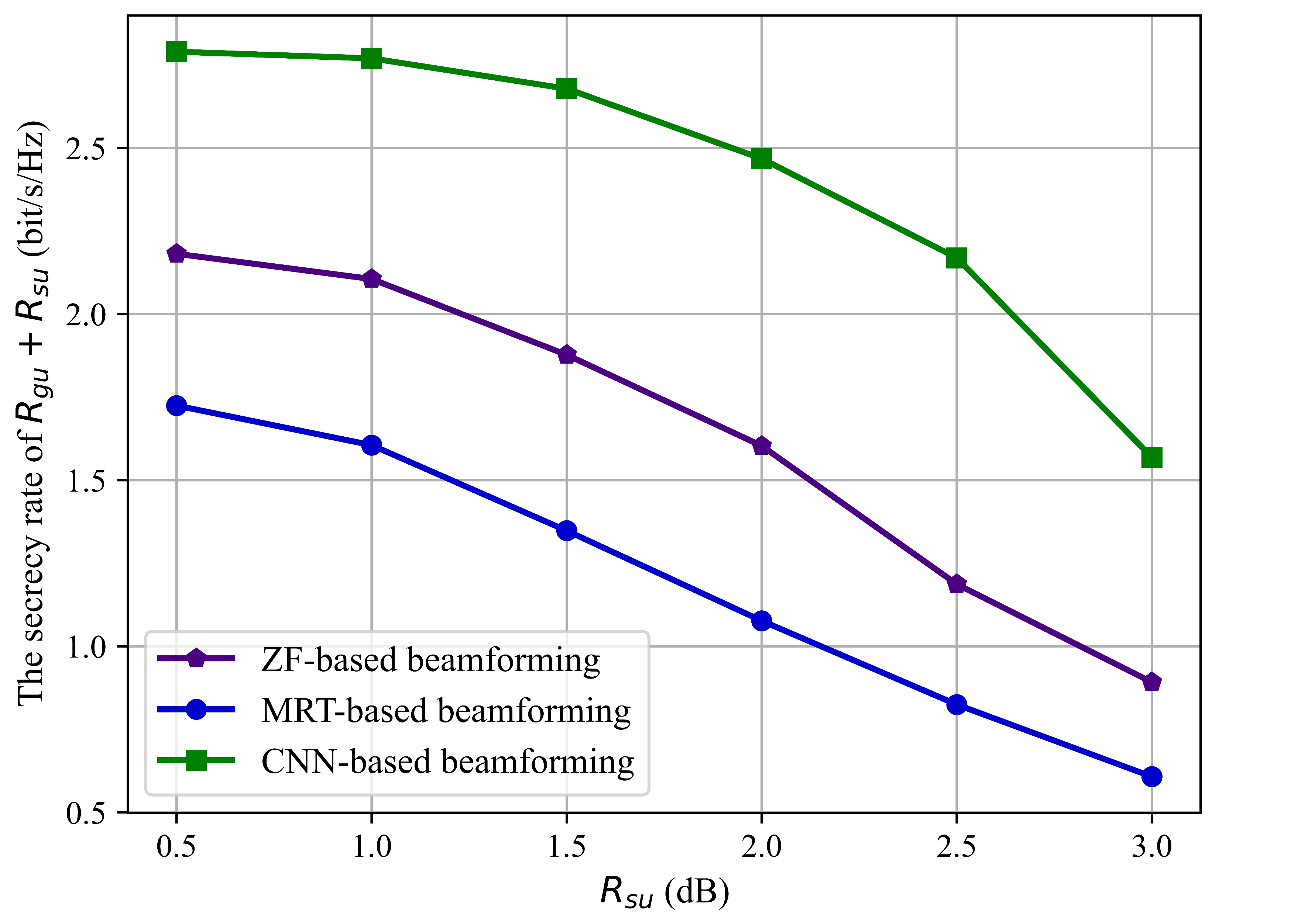
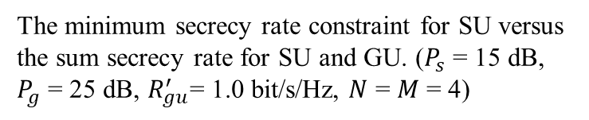
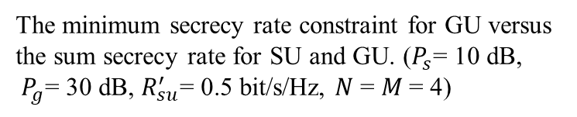
SIMULATION RESULT
The minimum secrecy rate constraint for GU versus the sum secrecy rate for SU and GU. ($P_{s}$= 10 dB, $P_{g}$= 30 dB, $R_{su}^{′}$= 0.5 bit/s/Hz, $N$ = $M$= 4)
The minimum secrecy rate constraint for SU versus the sum secrecy rate for SU and GU. ($P_{s}$ = 15 dB, $P_{g}$ = 25 dB, $R_{gu}^{′}$= 1.0 bit/s/Hz, $N$ = $M$ = 4)
Notes:
These figures illustrate the relationship between the minimum secrecy rate constraint for GU or SU and the sum secrecy rate for SU and GU. We can observe that with the minimum secrecy rate constraint for GU or SU increasing, the sum secrecy rate of SU and GU decreases. The CNN-based beamforming scheme we proposed outperforms MRT-based and ZF-based beamforming methods. This is because, as the minimum secrecy rate constraint for GU or SU increases, the beamforming from both the BS and the Sat focuses more on the eavesdropping channel for GU or SU, thereby reducing the impact on the increase in the primary channel for SU or GU and the disruption of the eavesdropping channel for SU or GU.
这些图表展示了GU或SU的最低保密率约束与SU和GU的总保密率之间的关系。我们可以观察到，随着GU或SU的最低保密率约束增加，SU和GU的总保密率减小。我们提出的基于CNN的波束成形方案优于基于MRT和基于ZF的波束成形方法。这是因为随着GU或SU的最低保密率约束增加，来自基站和卫星的波束成形更加集中在GU或SU的窃听信道上，从而减小了对SU或GU主信道增加的影响以及对SU或GU窃听信道干扰的影响。

Slide 18
THANKS
Notes:
That’s all my presentation. Thank you for your listening.

